Slide 1
The Pre Separation Claim Process BDD
Mark W. Barett MS, MPA
Associate Director, Field Operations, NVS
mbarrett@vfw.org
mark.barrett@va.gov
619-797-7809

Slide 2
Lesson Plan
Understanding Pre-Discharge claims
Knowing the claim process time-table
Preparing to file your pre-separation claim **
Understanding service connection
Understanding the Examination Process ***
Additional evidence

Slide 3
The Game Plan for Success
Thorough Preparation
VA Examination Process
Evidence review, Rating decision, Award Letter
Decision in Hand

Slide 4
Pre-Discharge Claims
Benefits delivery at discharge [BDD]
Typically mailed to recipient w/in 30-day window following separation
Fully developed claim process [FDC]
Claim process begins following separation from service

Slide 5
Pre-Discharge Claims
Benefits delivery at discharge (BDD)
180-90 days from EAOS [day for day to include last day]
Priority level high
Rating Decision should be complete shortly following separation
VA Contract Examination QTC / VES / LHI
Fully developed claim process [FDC or BDD Excluded]
89 days or less from EAOS to include post service
Lesser priority level
Development may not start until after separation
VA Contract Examination QTC / VES / LHI / VHA

Slide 6
BDD Claim Type (graphically)
BDD Claim (180 – 90)
Claim generation & transmission to VA
Request for contract Examination
Immediate (non-discretionary)
QTC, VES, LHI Exam (only)
Examinations
Returned to VA & Evaluated
VSR Reviewed
IF ok fwded to RVSR
RVSR
Generates draft
Rating Decision
Decision Ltr:
VSR generates
Award Ltr
Decision Ltr:
Mailed to Veteran

Slide 7
BDD (Excluded) Claim Type (graphically)
BDD Excluded Claim (89 – 1)
Claim generation & transmission to VA
Request for contract Examination
Discretionary
QTC/ VES/LHI or VHA Exam
Examinations
Returned to VA & Evaluated
VSR Reviewed
IF ok fwded to RVSR
RVSR
Generates
Rating Decision (post service)
Decision Ltr:
VSR generates
Award Ltr
Decision Ltr:
Mailed to Veteran

Slide 8
Preparing to file VA claim
Documentation necessary for Pre separation claim filing
Don’t forget that you may have dependents

Slide 9
Preparing to file VA claim
Military documentation necessary for your VA Claim
Ahlta Record (Electronic Medical Record
Armed Forces Health Longitudinal Technology Application
2005 – Feb 26, 2021
Genesis Record (Electronic Medical Record)
Feb 27, 2021 – Present
Hardcopy Medical and Dental Record
Scanned (150 Mb limit per attachment)
Absolutely necessary (Service preceding 2005)

Slide 10
Preparing to file VA claim
Private Treatment Records (if applicable)
Medical and Psychological Records
Do not assume, if outsourced, treatment notes are available in military records
Sleep Studies and CPAP Receipts
Dependents
-- Spouses (including military spouses)
-- Biological/Step-Child/Adopted Child (preceding 18 yrs of age)
-- School Age Child 18 yrs – preceding 23 yrs of age (attending 2/4 yr accredited college)

Slide 11
VA forms
Claim form
VA form 21-526ez
To claim dependents
VA form 21-686c
VA form 21-674 (school age Child)
To claim PTSD
VA form 21-0781 (Combat & Non-Combat)
VA form 21-0781a (military sexual trauma ONLY)
VA form 21-10210 (use to provide any statement)

Slide 12
Special Circumstance Documentation
Certain claimed issues may need additional documentation
Logs indicating recurrence [Migraine Headaches, Vertigo, etc]
Stressor statement (PTSD only)
Diagnosis and treatment supports incurrence in service

Slide 13
VA forms weblink
Weblink to find fillable forms online
https://www.va.gov/find-forms/
Pre-Separation VFW Locator
Pre-Discharge Locations and Contacts - VFW

Slide 14
The Examination Process
Contract Exam QTC / VES / LHI [BDD]
Exams are in geographic area where claim filed
Availability Requirements
The book says 45 days
Two phases of examination
Questionnaire
Physical Assessment
Decisions have consequences
What if I miss an exam?

Slide 15
Examination Psychology
You are leaving the military!
Be specific
Avoid verbiage that necessitates interpretation
Two-part exam
Exam Questionnaire
Exam Assessment

Slide 16
Where to File claim
File VA claim through a VFW VSO
VFW BDD sites locally: JB Anacostia-Bolling, JB Andrews, FT Myers, Bethesda, and NCR
VFW legally represents you throughout the claim process and beyond.
File directly through VA military service coordinator (MSC) or online at www.va.gov
MSC’s are VA representatives that can help you submit your VA claims
All major military installations have MSC’s
MSC’s assist you, however, they do not represent you.

Slide 17
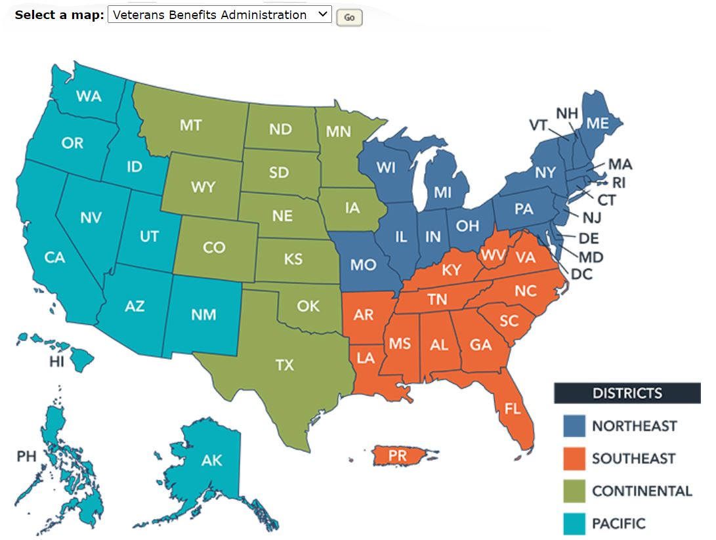
Reach
56 VA Regional Offices [worldwide coverage]
56 VFW Service Offices [worldwide coverage]

Slide 18
VA Healthcare
Begin the process
Sign up for VA Healthcare online at www.va.gov
under the VA healthcare portal
Healthcare groups are determined by Service-Connected percentage or Needs based.

Slide 19
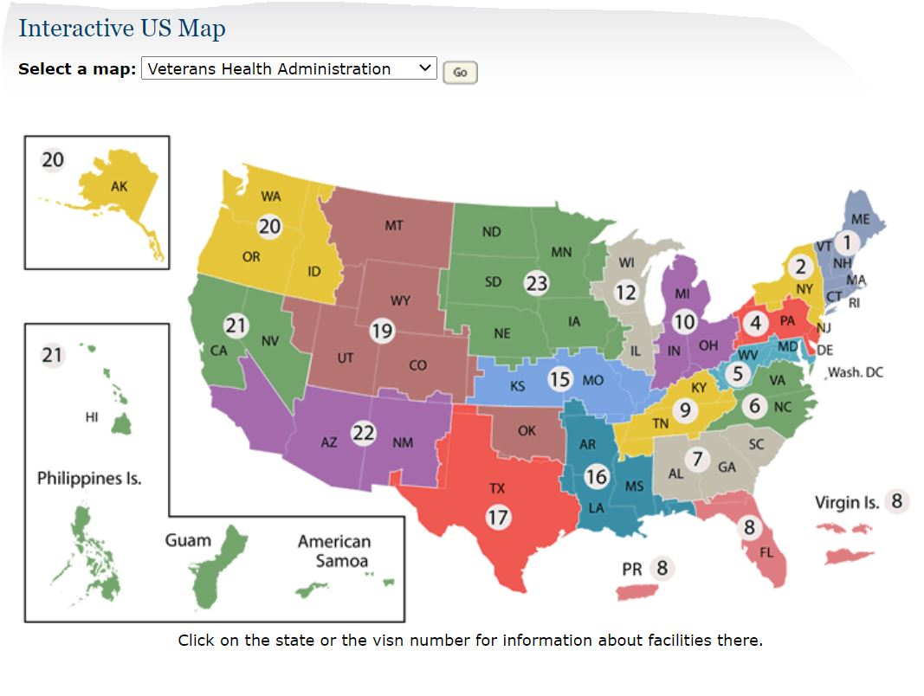
Reach - Healthcare

Slide 20
Point of Contacts
Veterans of Foreign Wars
VFW Washington DC bdd@vfw.org
JB Andrews and JB Anacostia-Bolling
Kevin Buckner kbuckner@vfw.org
Fort Belvoir // Melissa Gilliam mgilliam@vfw.org
Naval Support Activity Annapolis and
Navy Yard // Miranda Drummond mdrummond@vfw.org
VA Military Service Coordinators (MSC)
All major installations have MSC’s servicing specific areas

Slide 21
Additional Resources
VFW help Online
www.vfw.org
Locate a VFW Service Officer
Pre Separation
Pre-Discharge Locations and Contacts - VFW
Post Service
www.vfw.org/assistance/va-claims-separation-benefits
VA Help Online
https://www.va.gov/
VA Hotline: 1-800-827-1000
VA Education: 1-888 442-4551

Slide 22
When do my benefits begin
Your VA decision should be completed shortly after separation.
Typically mailed out and received by Veteran w/in 15/30 days following EAOS
You will not know your official rating decision until after you separate from service
Ensure VA always has your correct contact information
Compensation begins to accrue 1st day of 1st month following separation

Slide 23
QUESTIONS?

